Slide 1
Building the Internet of Hams
Or: Everything is IoT (if you are brave crazy enough)

Slide 2

2 Key learnings
How is smoked food prepared
What should you consider in a successful IoT project

Slide 3
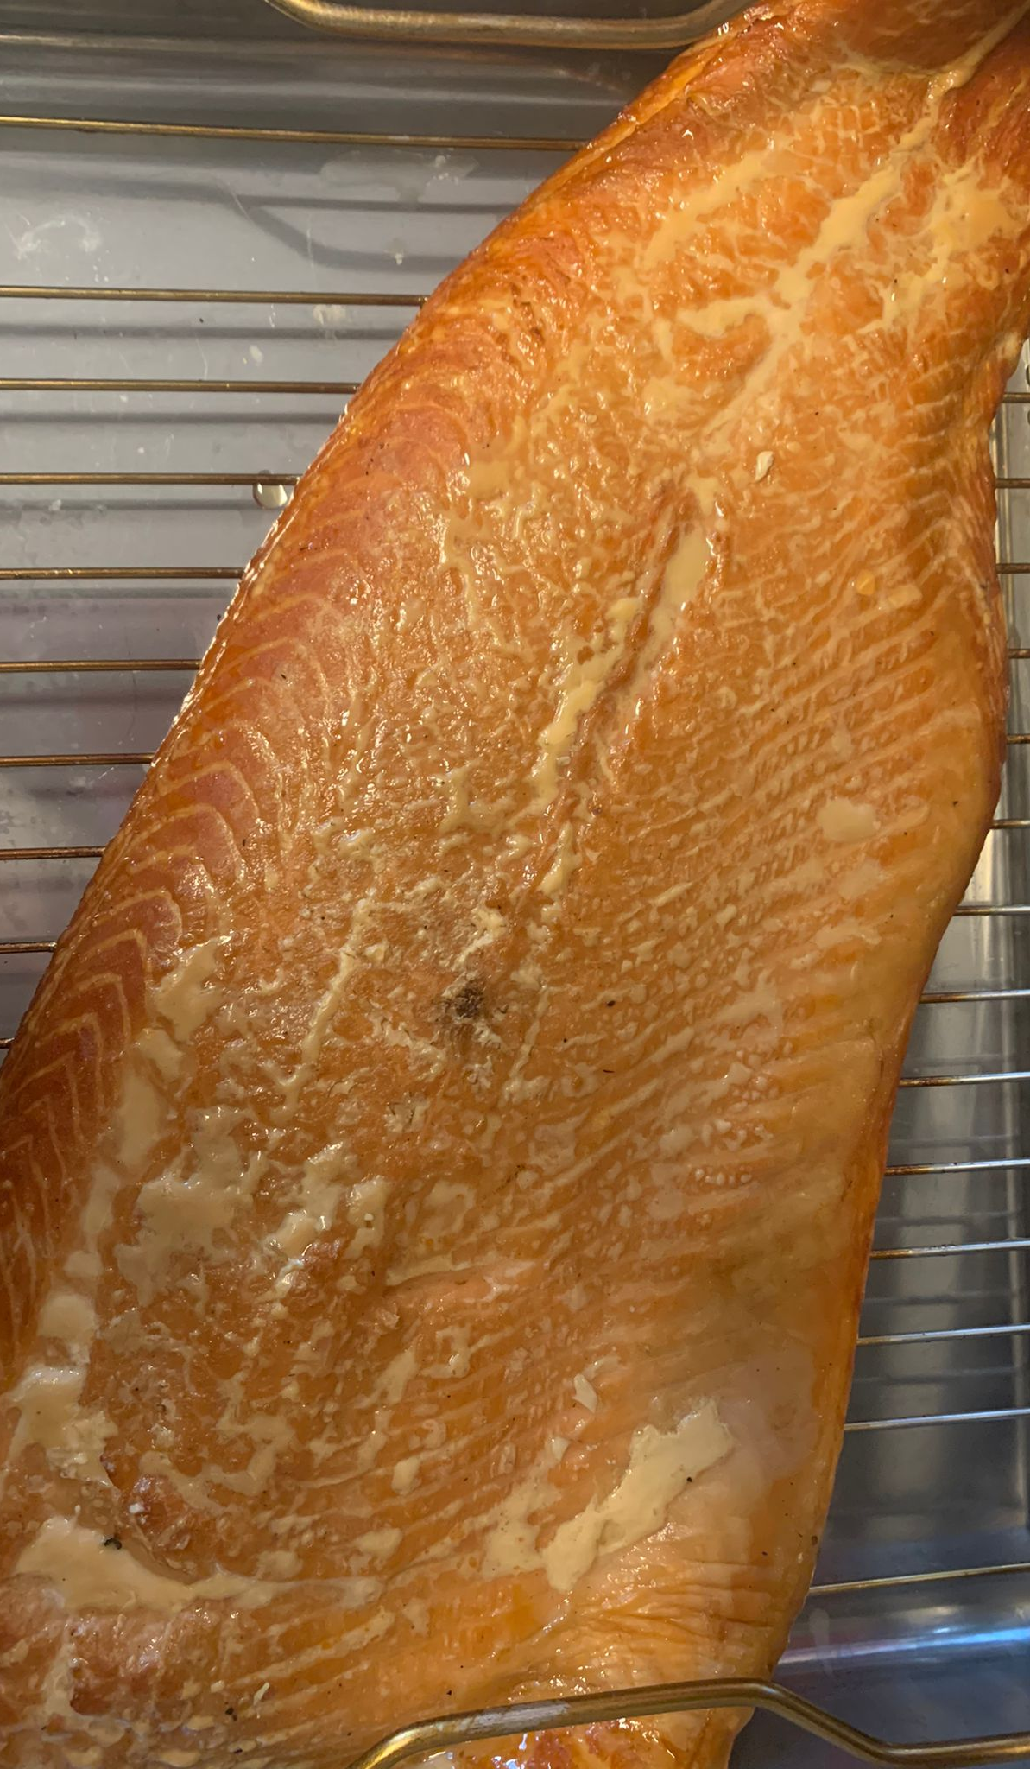
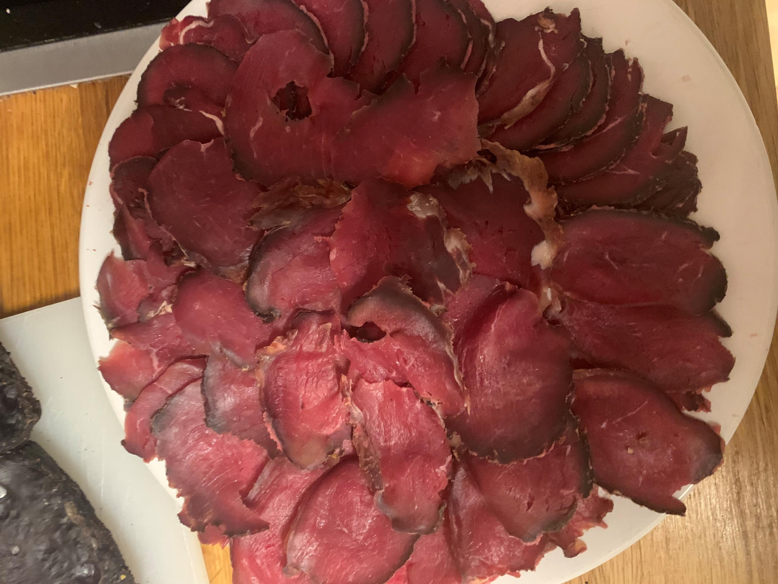
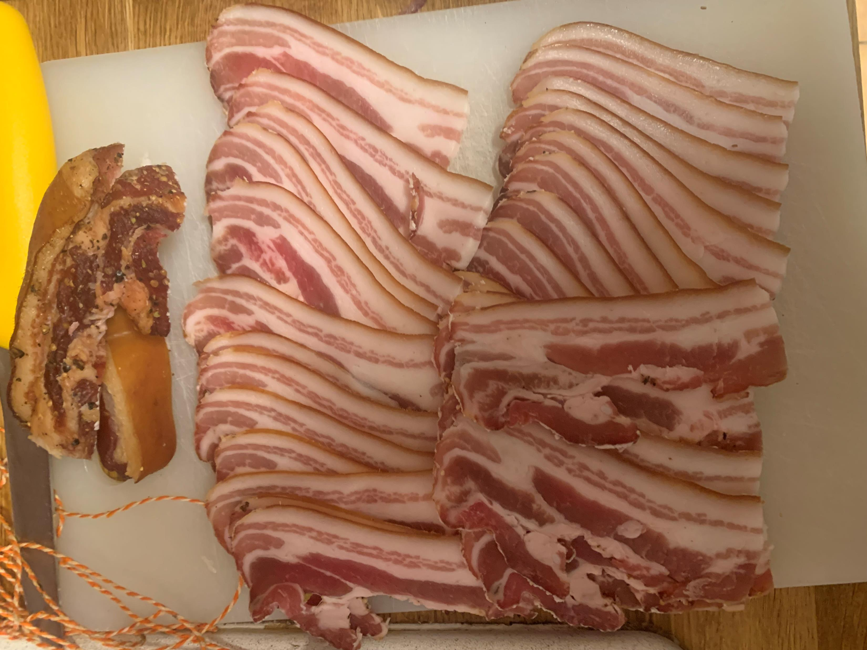

Slide 4
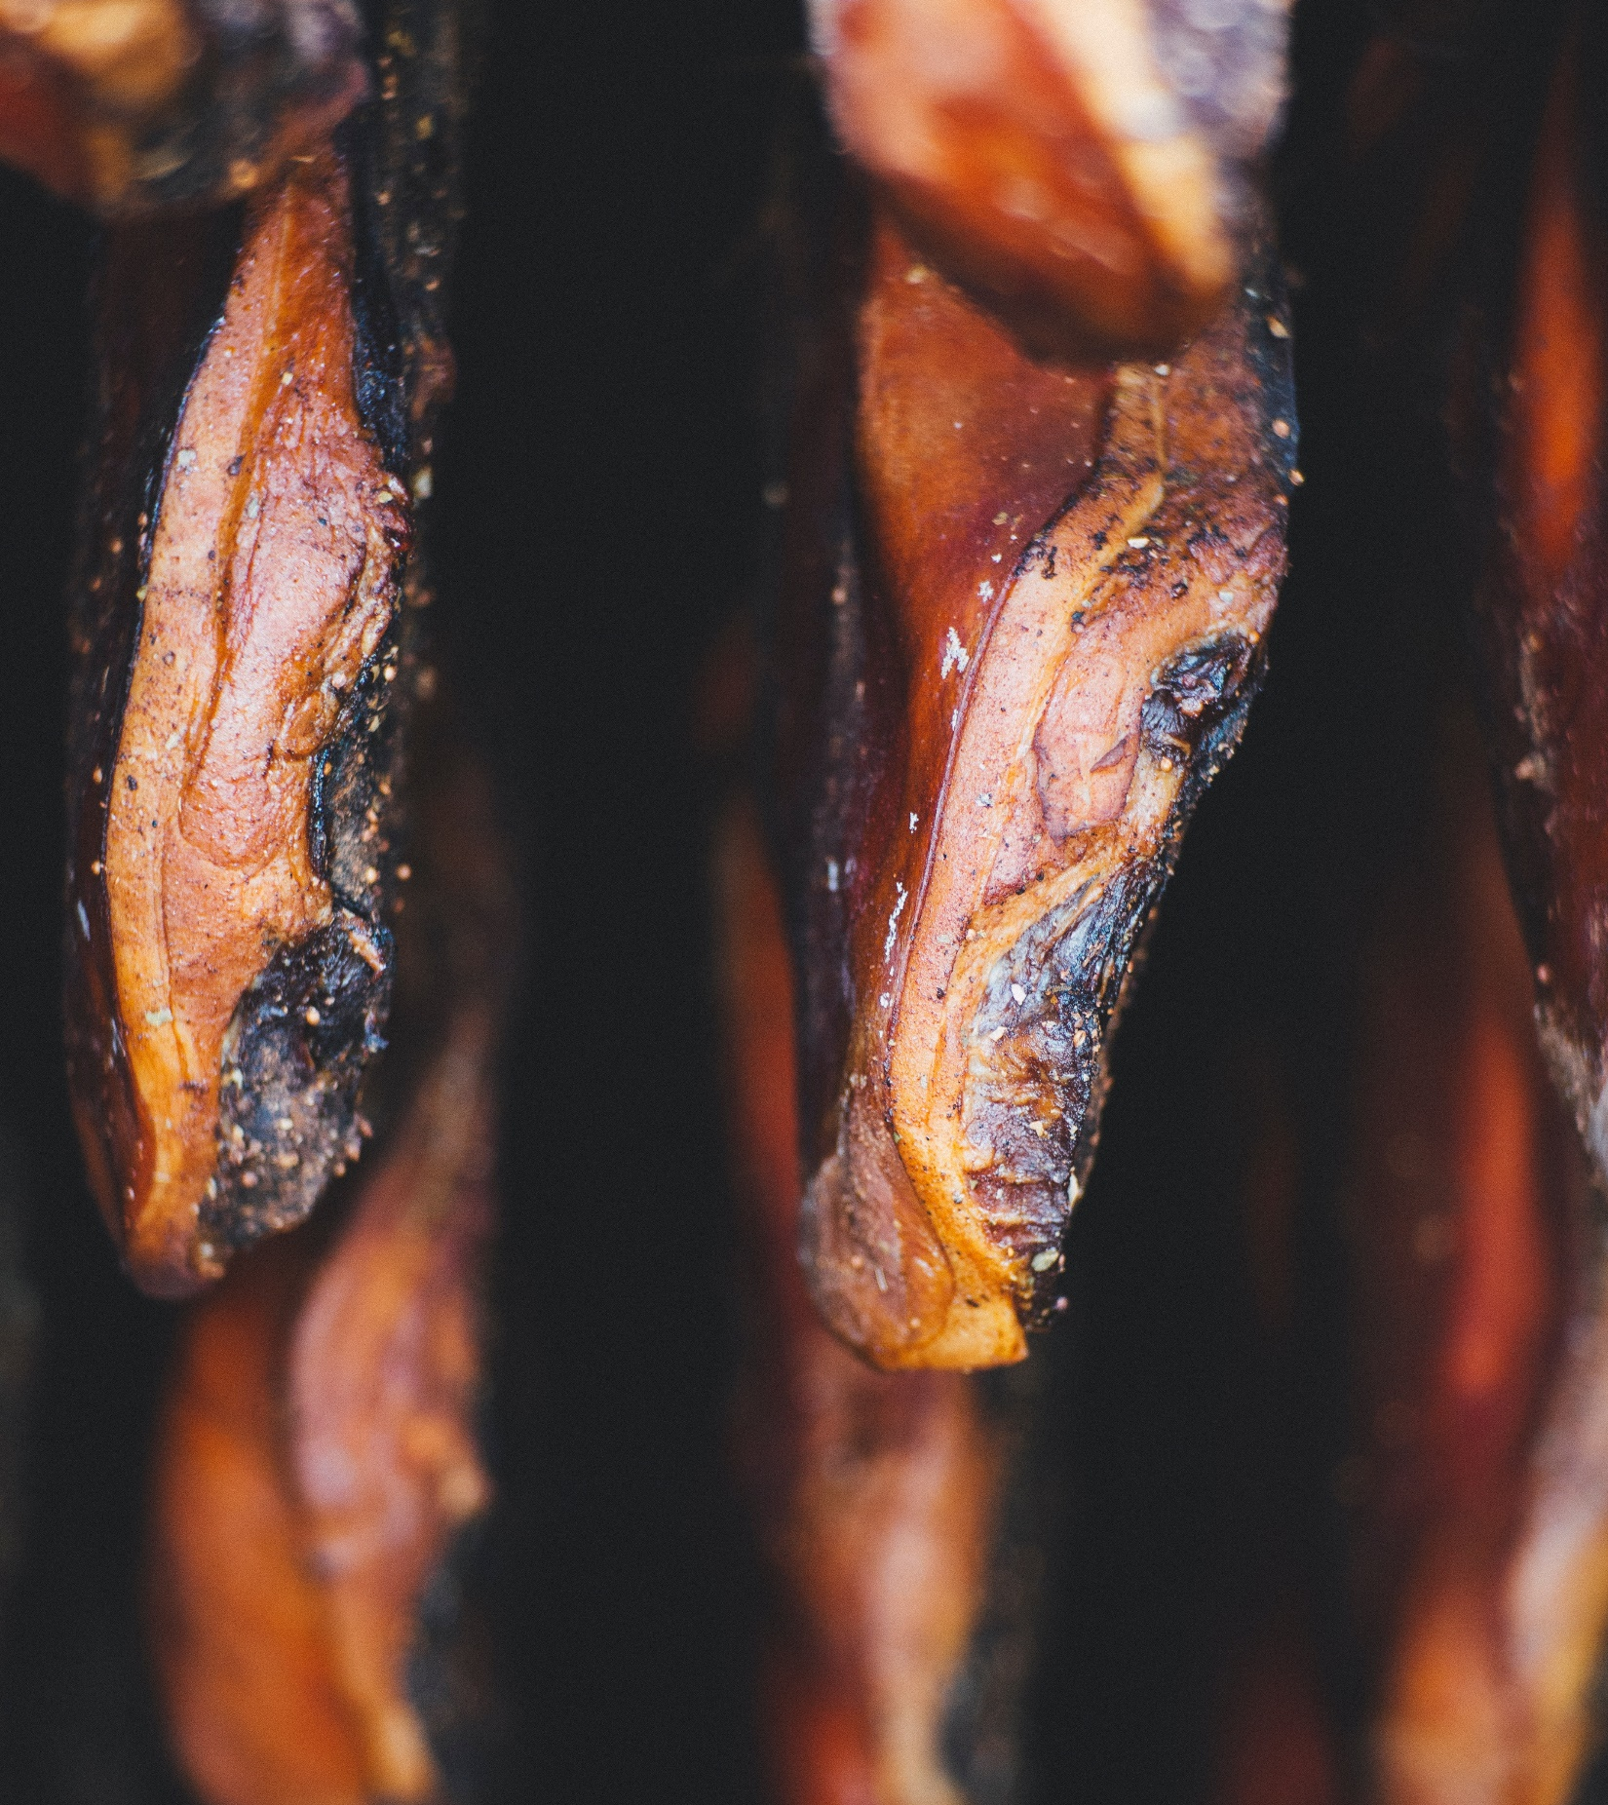
Smoking food
Smoking is the process of flavoring, browning, cooking, or preserving food by exposing it to smoke from burning or smoldering material, most often wood.

Slide 5

Dr. Benjamin Kettner/ Ben (He/Him)
Passionate about
My daughter
Good food
IoT Projects
Metal music
Data Platform MVP
Co-Founder & CTO ML!PA

Slide 6
Demo time!

Slide 7
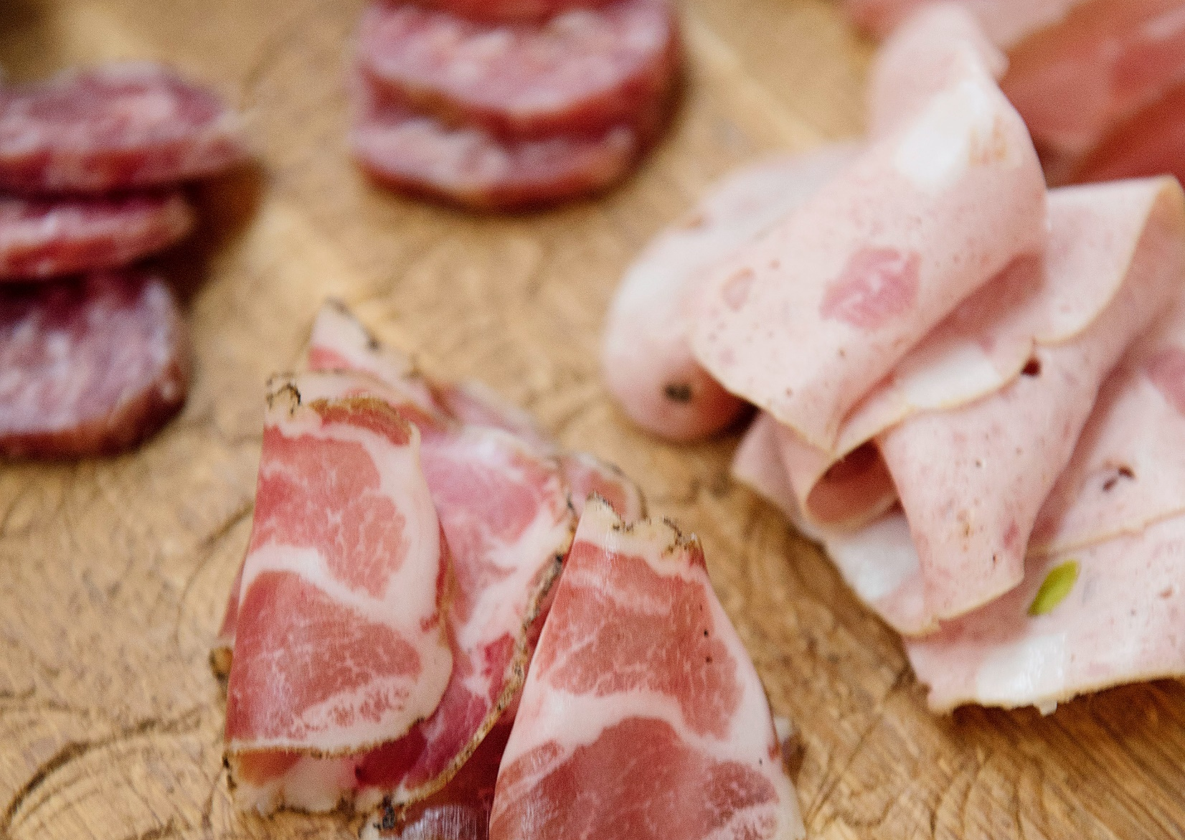
1st ingredient for the IoH: Smoke

Slide 8

Smoke comes from wood
Different types of wood give different tastes.
Oak: medium to strong flavor
Maple: light and sweet flavor

Slide 9
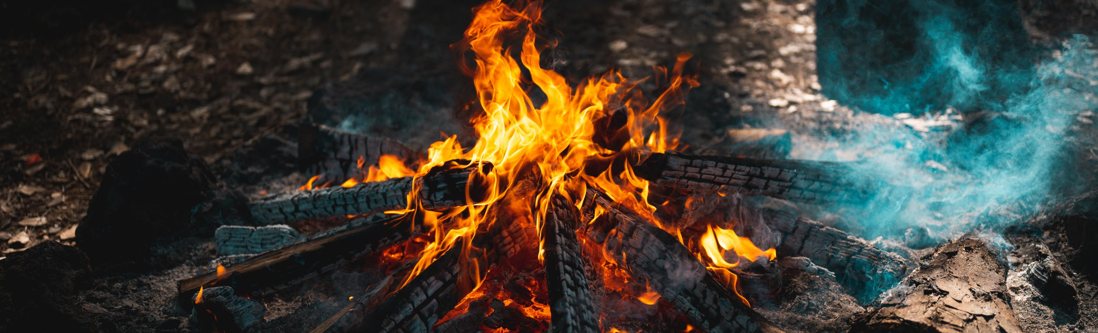
Different types of smoking
Cold smoking:
Only smokes the food
Low temperature (< 25°C)
Used for fish, bacon and ham
Hot smoking:
Smokes and cooks the food.
Higher temperature (~120°C)
Used for spareribs, fish and pulled pork

Slide 10
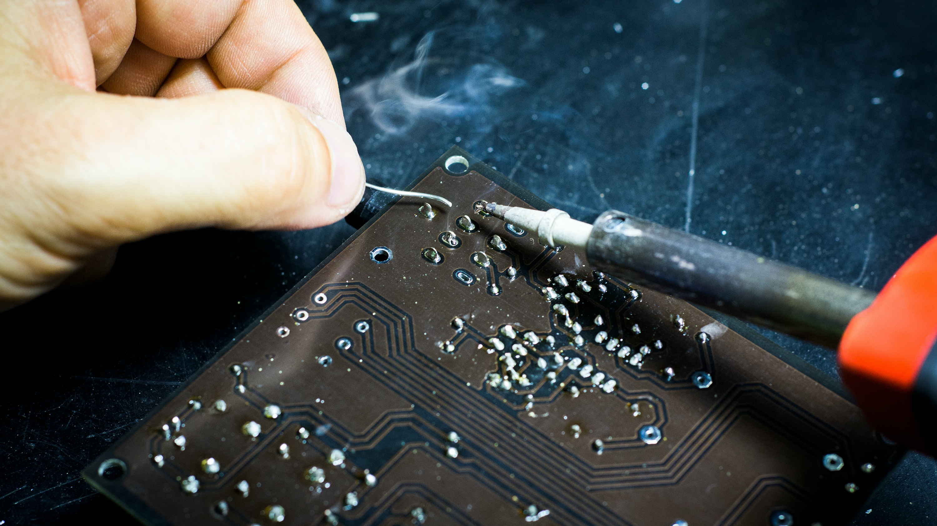
IoT lesson 1

Slide 11

Make sure your sensors match your environment
Normal PCB have 110°C as max operating temperature
High temperature PCBs can be operated up to 135°C.

Slide 12
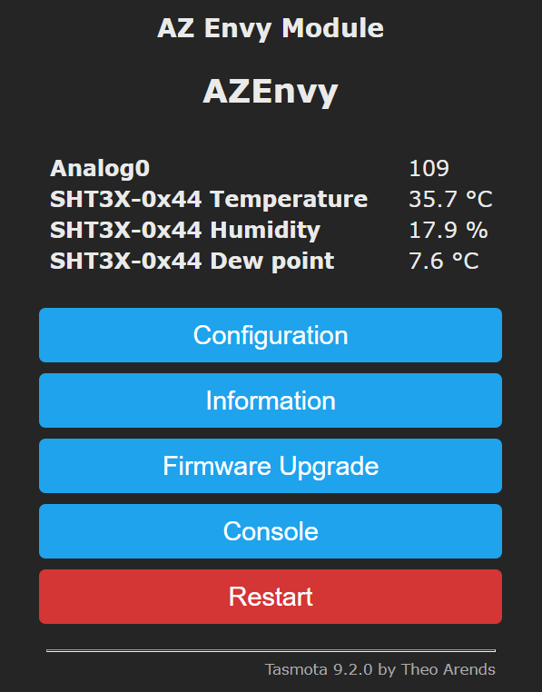
Detour: Sensor design
Problem: Sensor reporting too high temperatures

Slide 13
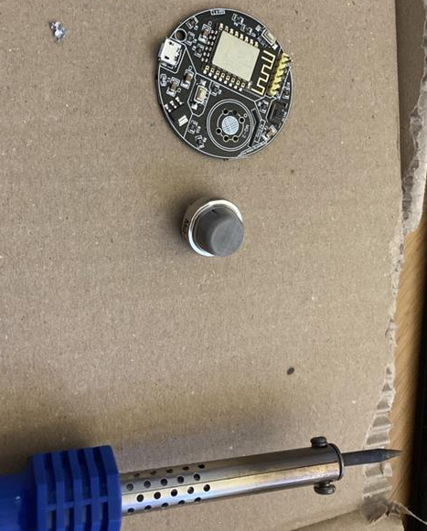
Detour: Sensor design
Cause: Gas sensor heats up and sits right next to temperature sensor.
Solution: Soldering…

Slide 14
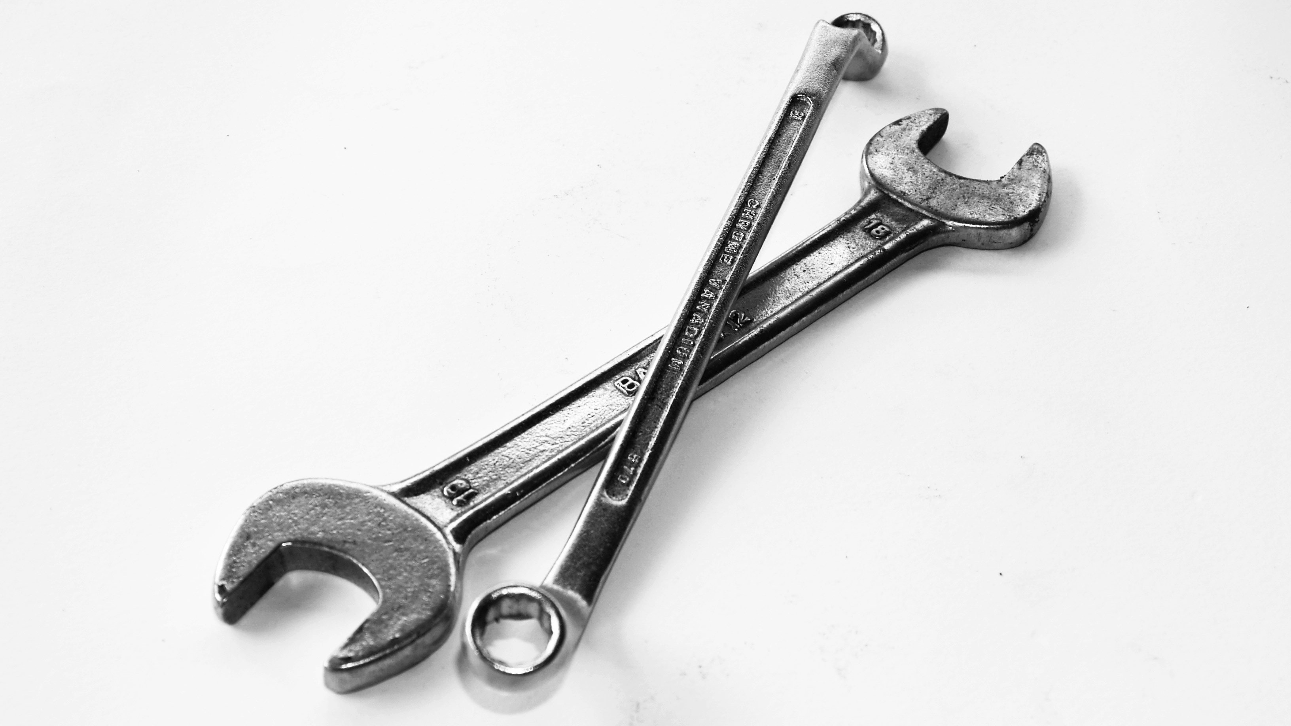
Tools for smoking

Slide 15
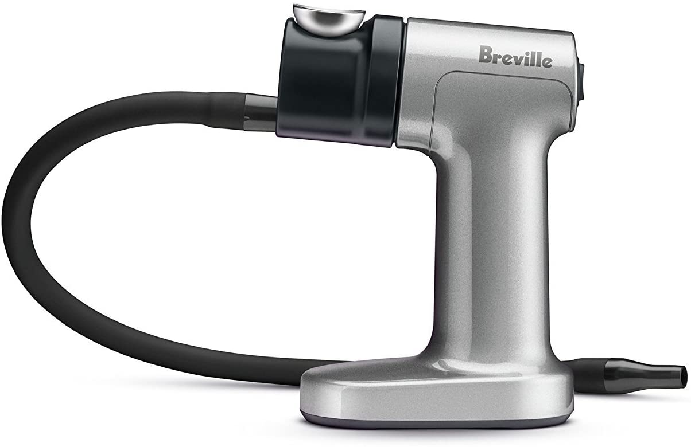
Smoke gun
Smokes for minutes
Cold smoke
Easy to use
Portable

Slide 16
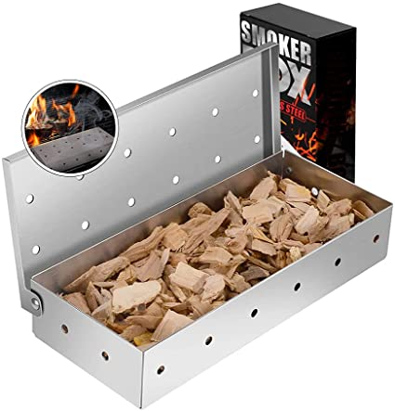
Smokebox
Smokes for ~1 hour
Hot smoke
Easy to use in BBQ

Slide 17
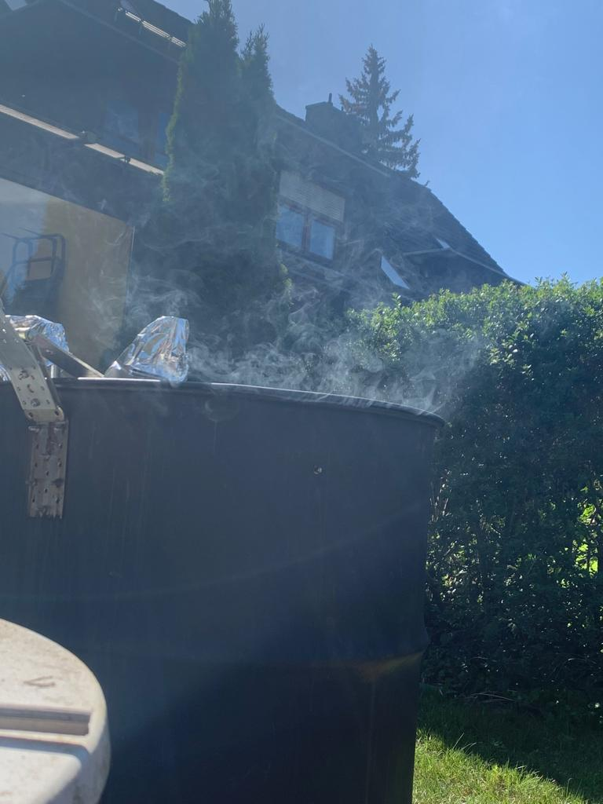
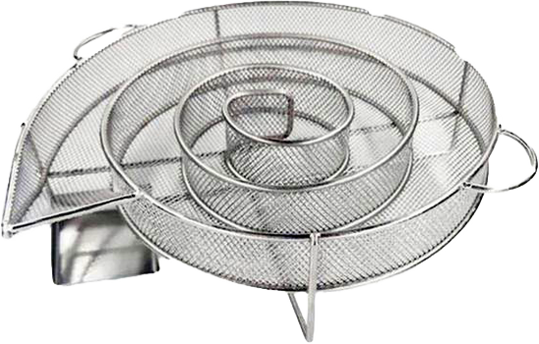
UDS
Hot smoke for several hours
Cold smoke for up to 10 hours
Not so portable

Slide 18
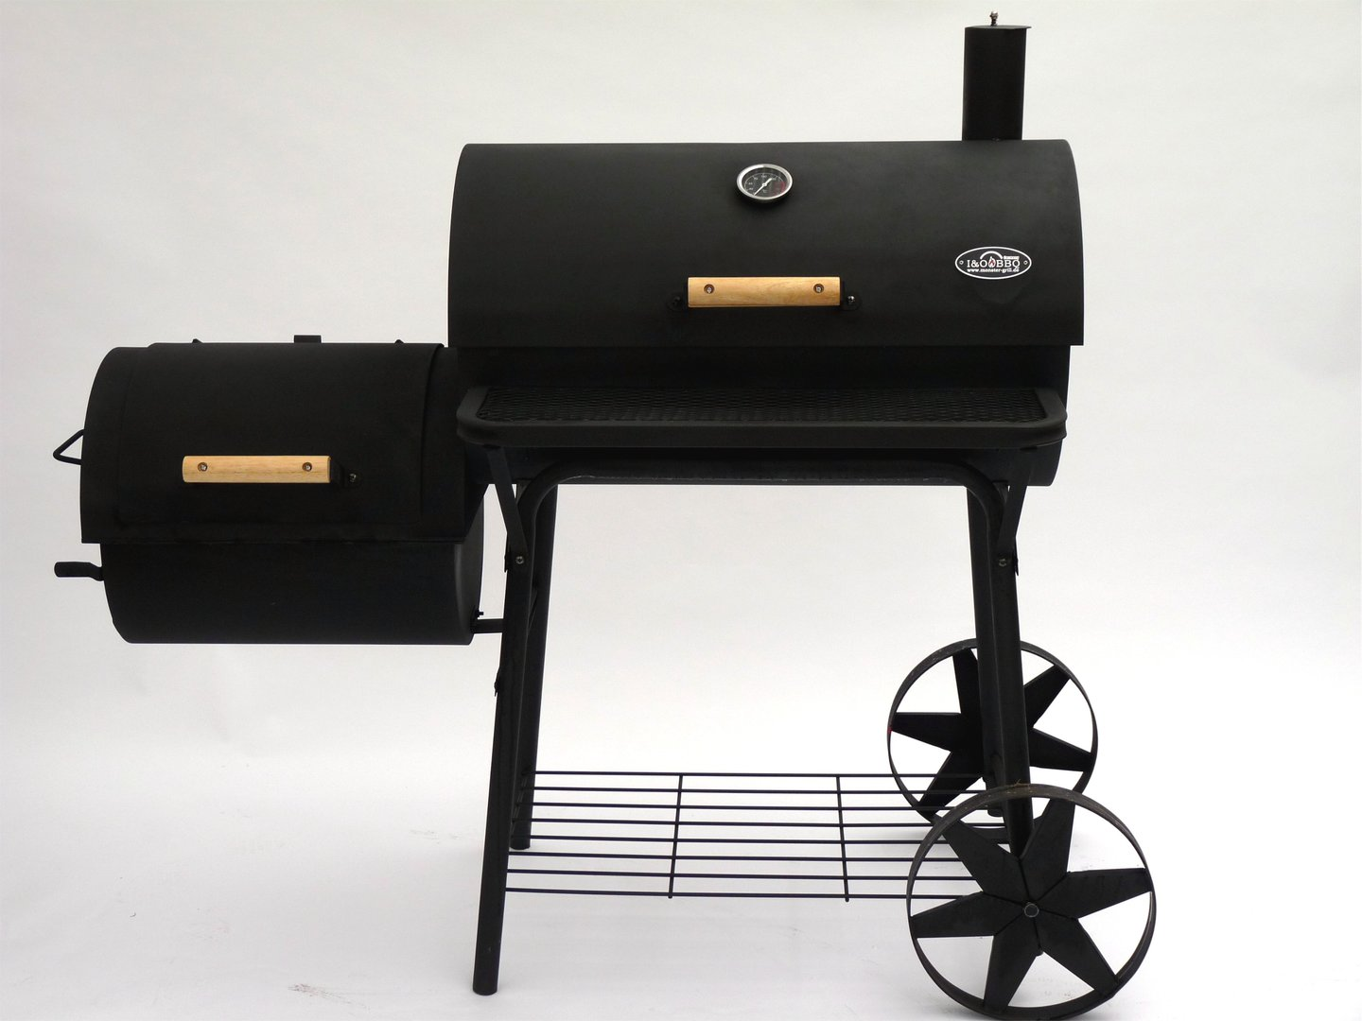
Sideburner
Not portable at all
Impressive
Hot smoking for many hours
No direct heat

Slide 19
2nd ingredient for the IoH: Time

Slide 20

Time matters
Time for brine to enter and flavour meat
Time for meat to be smoked

Slide 21
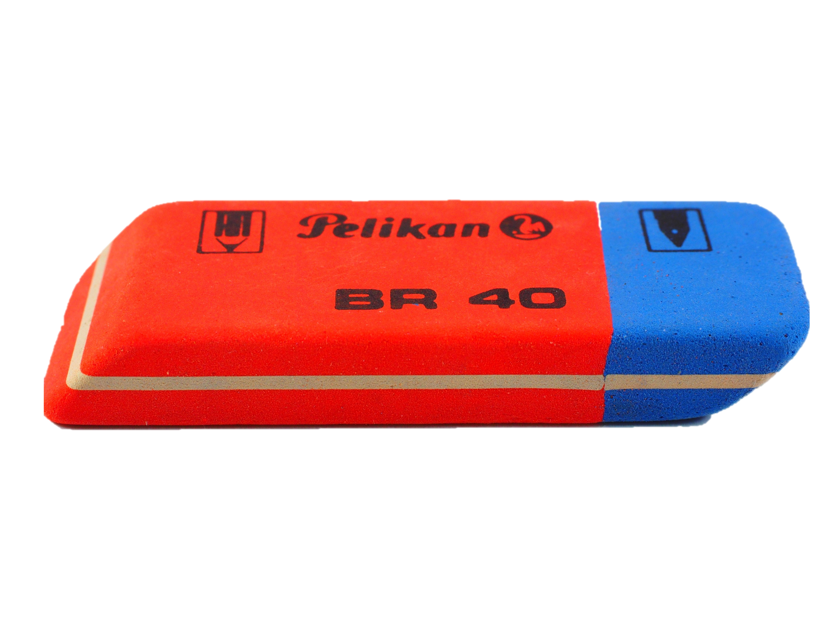
What happens if timing is off?
My meat has no eraser and Ctrl+Z does not work…
Time in brine: Longer is uncritical
Time in smoker: Timing is critical

Slide 22
IoT lesson 2

Slide 23

Consider sources of error
Find out where in the process things can go wrong.
Think about if you can monitor these problems and what you can do.

Slide 24
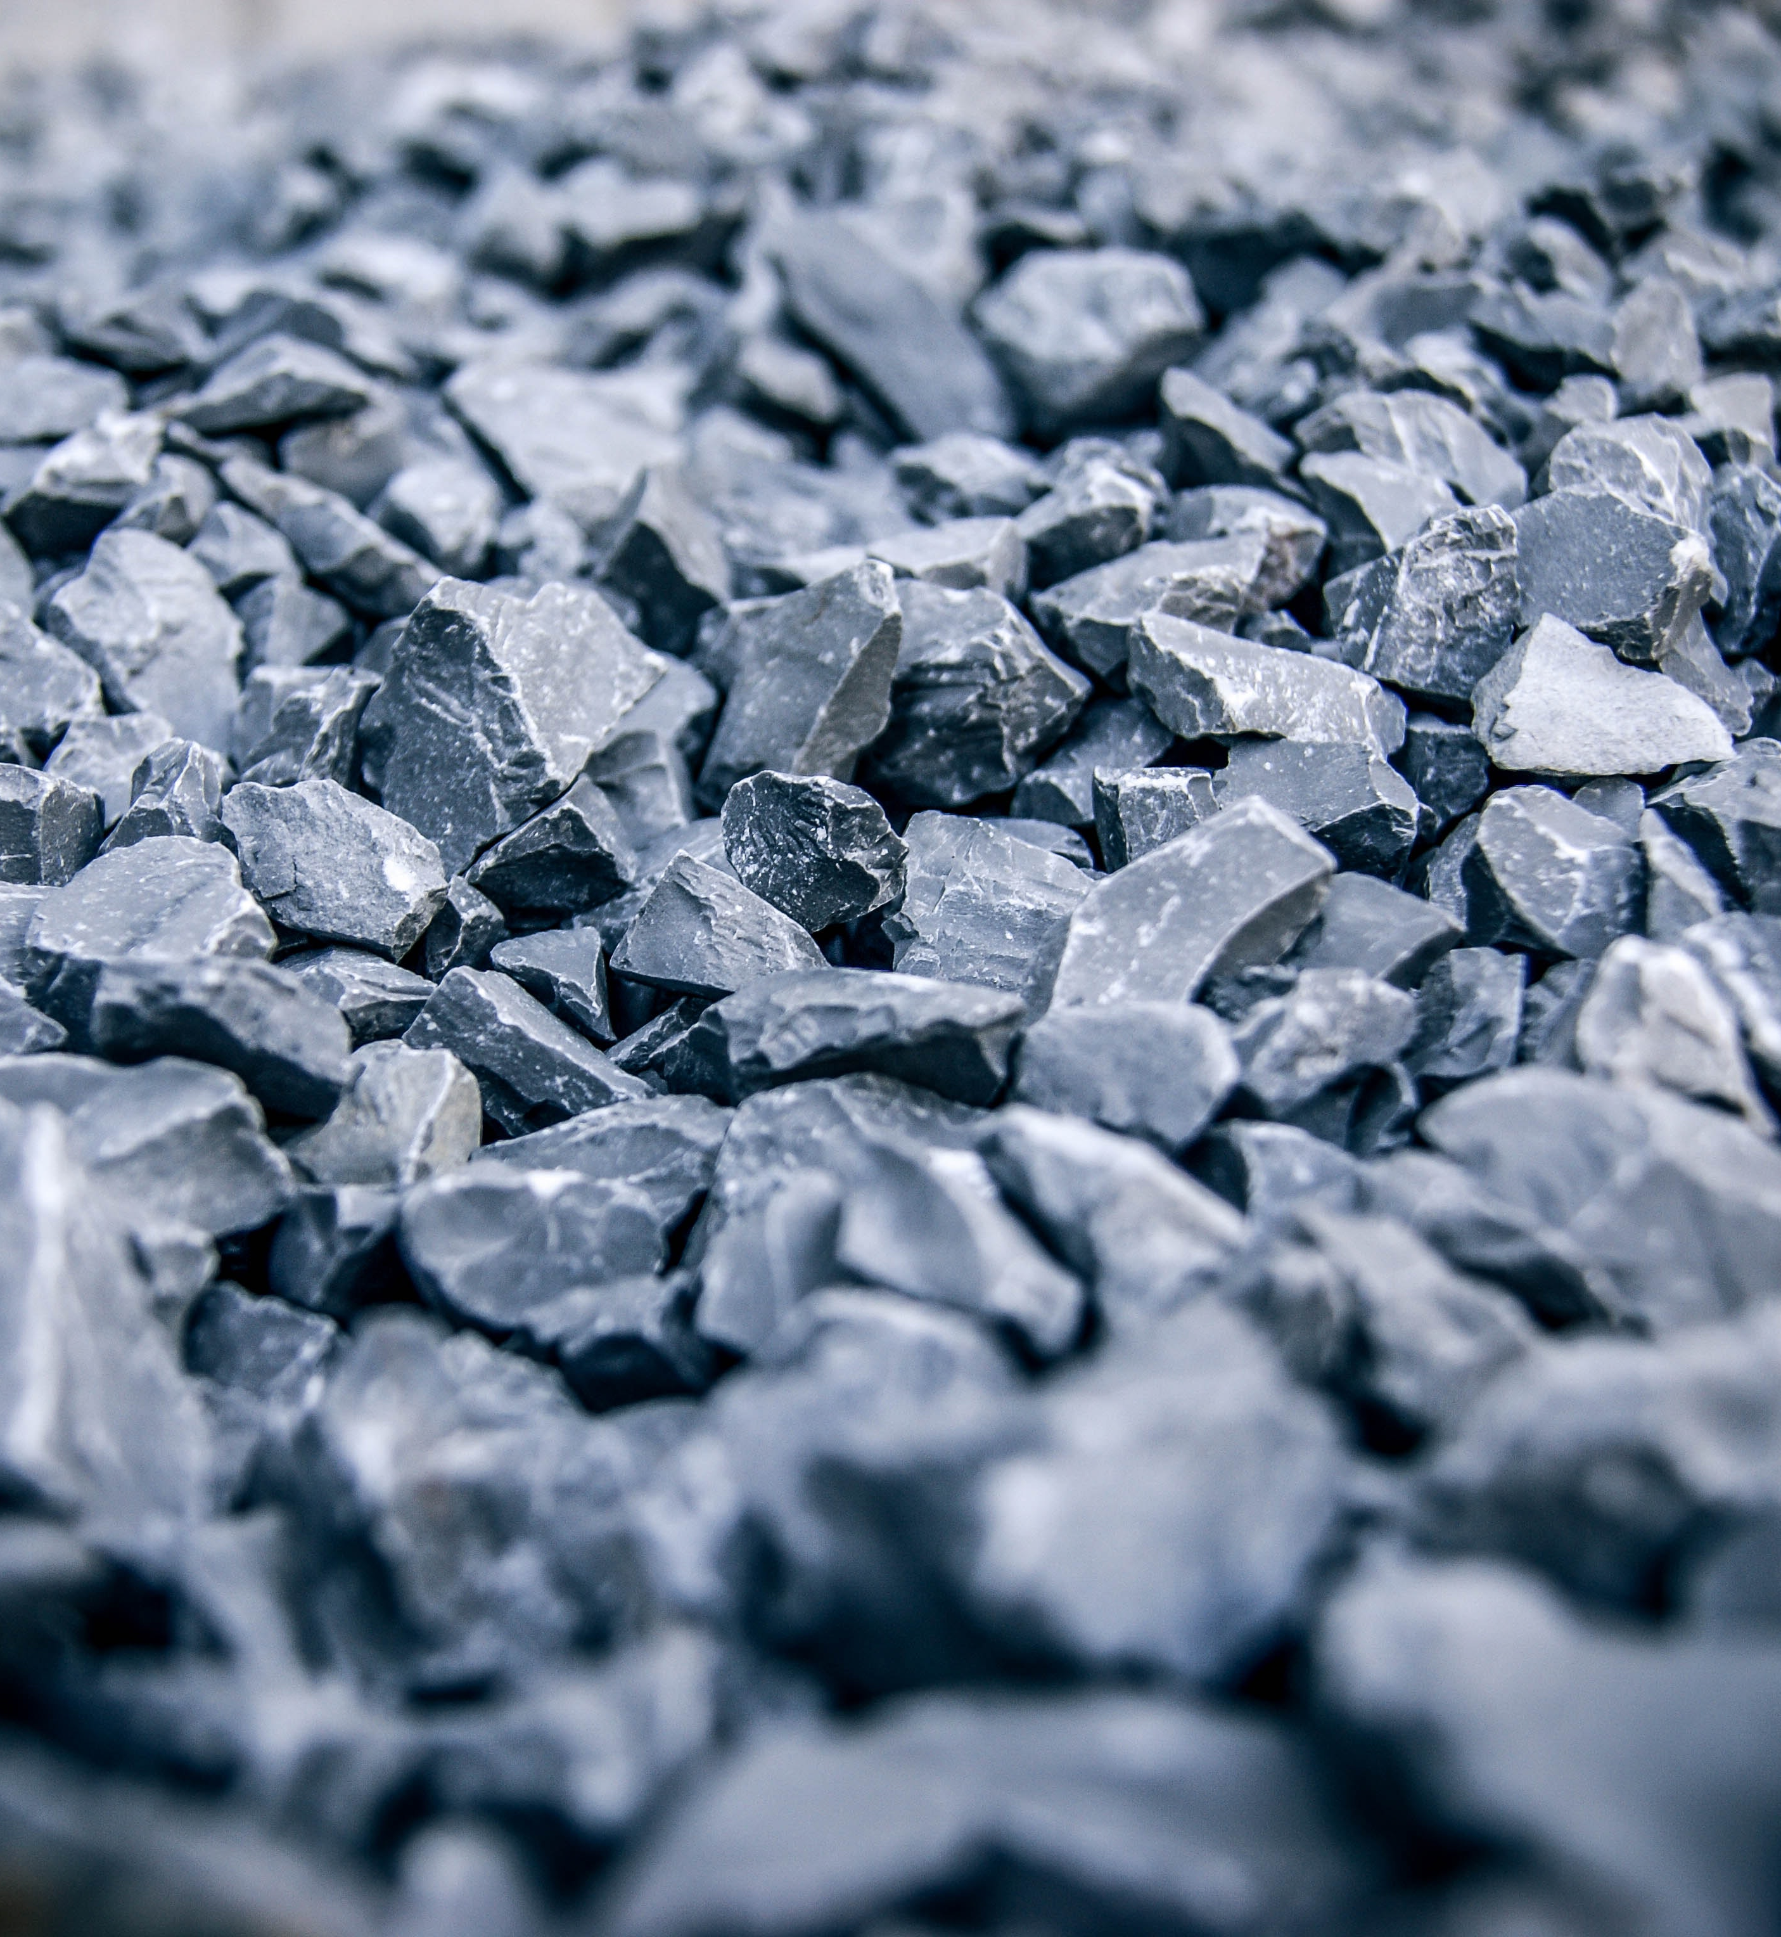
Learned the hard way
Ensure monitoring of your solution
Long-Running processes will mean unsupervised operations
If toolchain breaks, you loose data.

Slide 25
3rd ingredient for the IoH: Seasoning

Slide 26

What to add…
Curing meat with a brine that contains:
Salt: Removes water and thereby reduces growth of micro organisms
Nitrate/Nitrite: Kills bacteria, preserves meat color
Sugar: Is converted to acidic ingredients by micro organisms
Seasoning: Adds taste. I like Juniper, pepper, coriander

Slide 27
4th ingredient for the IoH: Meat

Slide 28
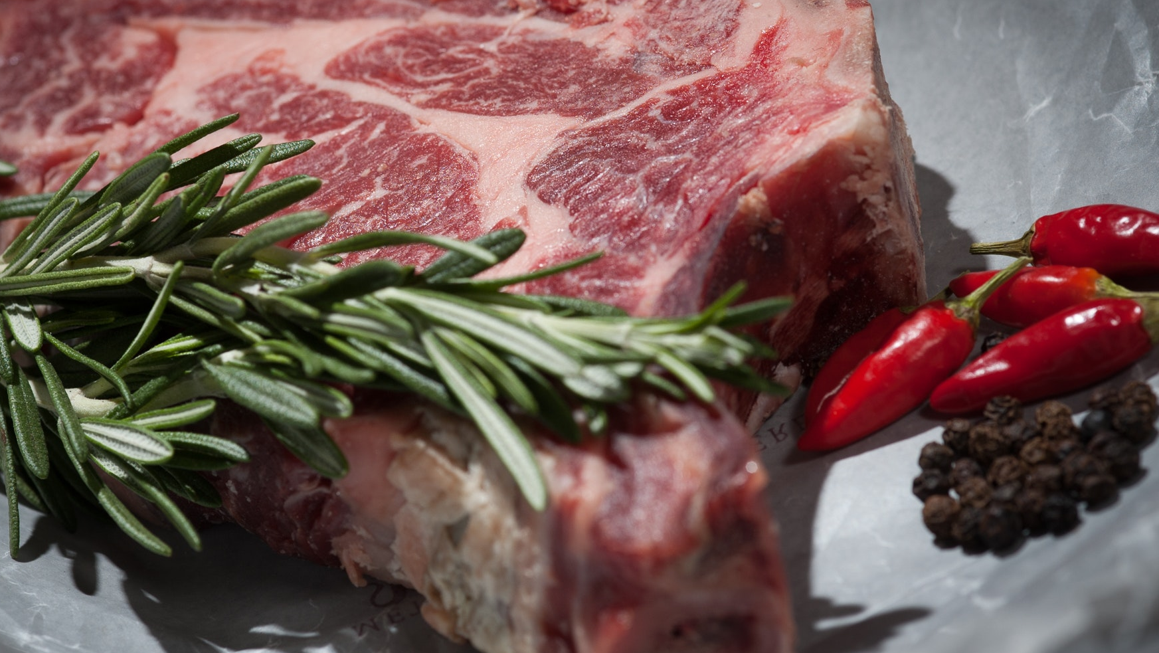
Fourth ingredient of IoH: Meat/Cheese/…
Ensure highest quality of ingredients to avoid food going off
Ensure highest standards of cleanliness

Slide 29

Putting it together
Meat + Seasoning + Brine + Time
= Cured meat
Cured meat + Time
= Dried cured meat
Dried cured meat + Smoke + Time
= Deliciousness

Slide 30
IoT lesson 3

Slide 31
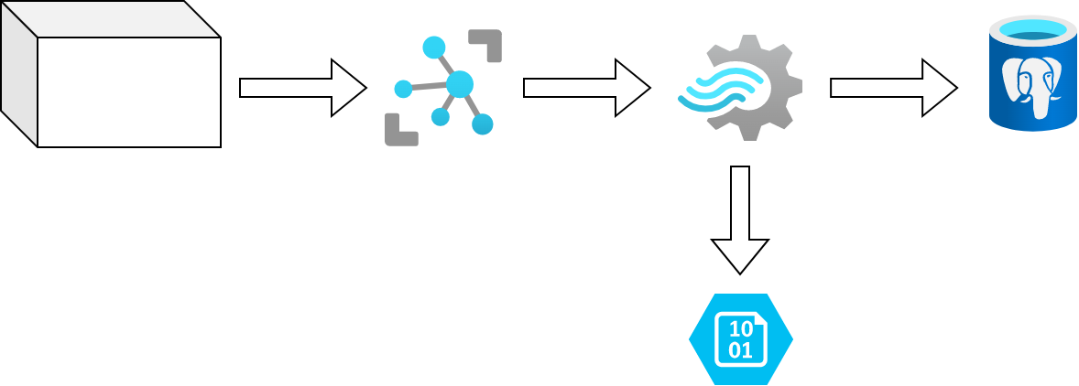
Architecture v1
Stream
Analytics
IoT Device
IoT Hub
Time
series DB
Blob storage

Slide 32
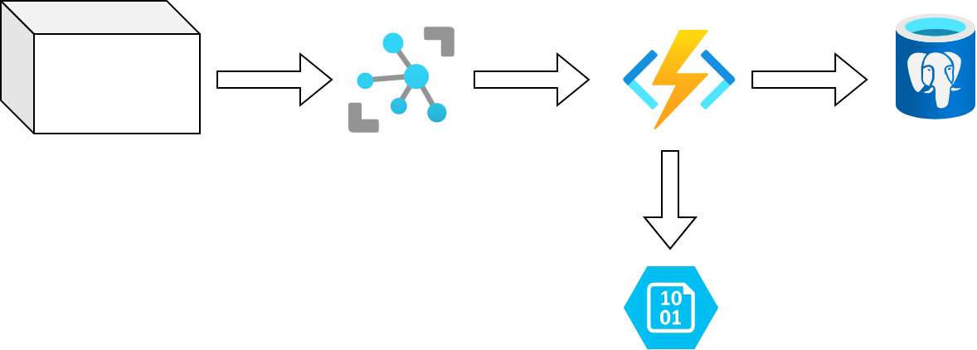
Architecture v2
Azure
Function
IoT Device
IoT Hub
Time
series DB
Blob storage

Slide 33

Storage patterns
The way you store your data matters!
The technology you use matters!
Learn the differences.

Slide 34
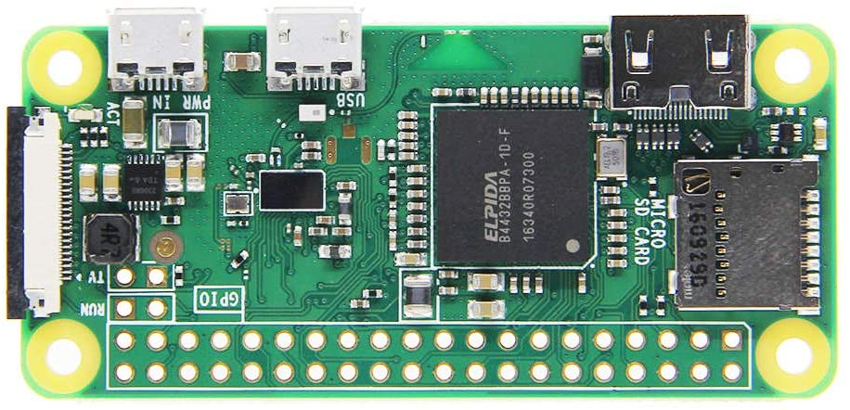
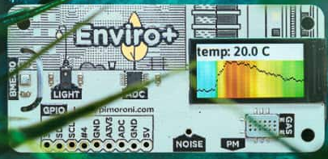
Hardware setup
Raspberry Pi Zero W: ~9€
Enviro+ Shield: ~50€

Slide 35
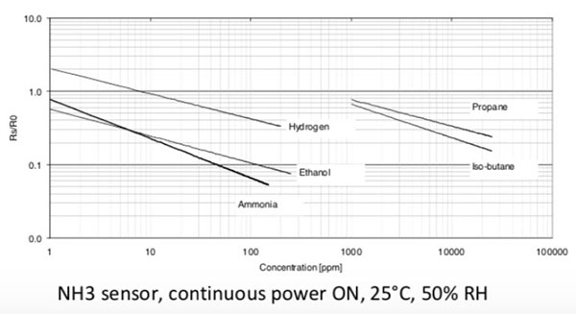
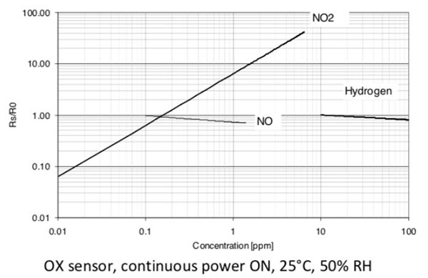
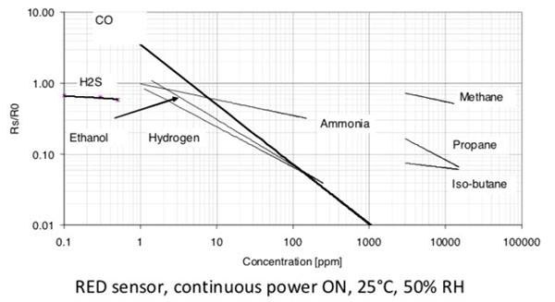
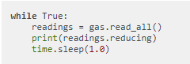
Enviro+ Shield gas sensor
https://github.com/pimoroni/enviroplus-python/blob/master/examples/gas.py

Slide 36
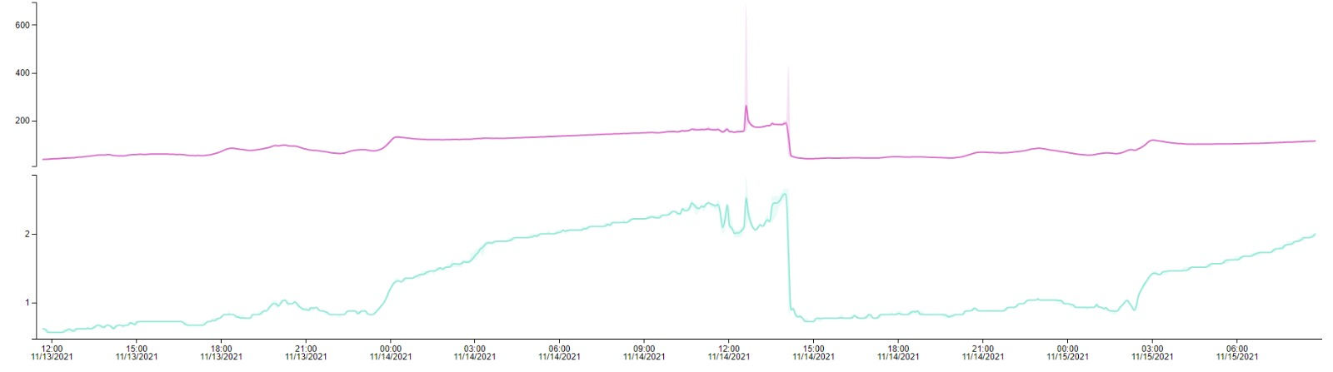
Results
OX
RED

Slide 37
IoT lesson 4

Slide 38
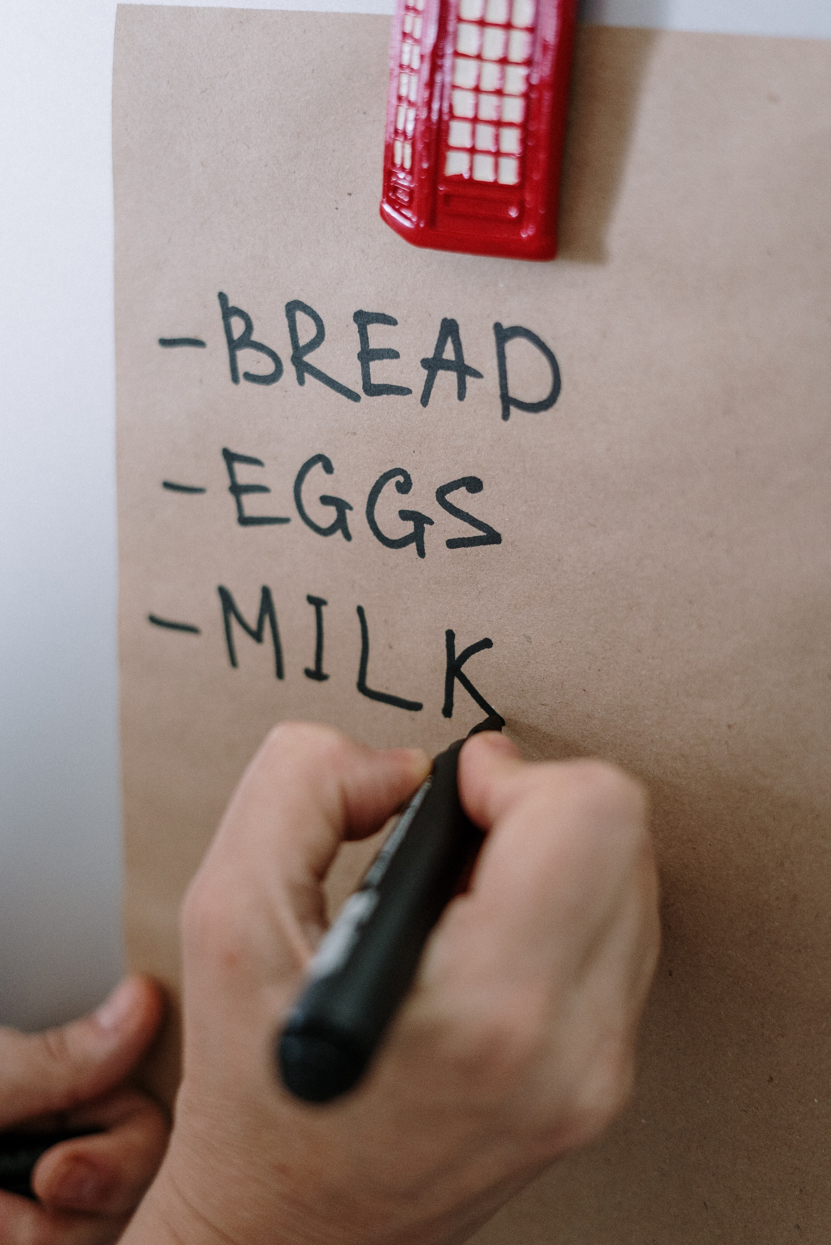
What do you need for successful IoT?
Understand
your processes
what parts of the process are error-prone
what parts of the process can be monitored
the cost for monitoring the processes
the benefit of monitoring the processes
Get the right hardware and understand how it works

Slide 39
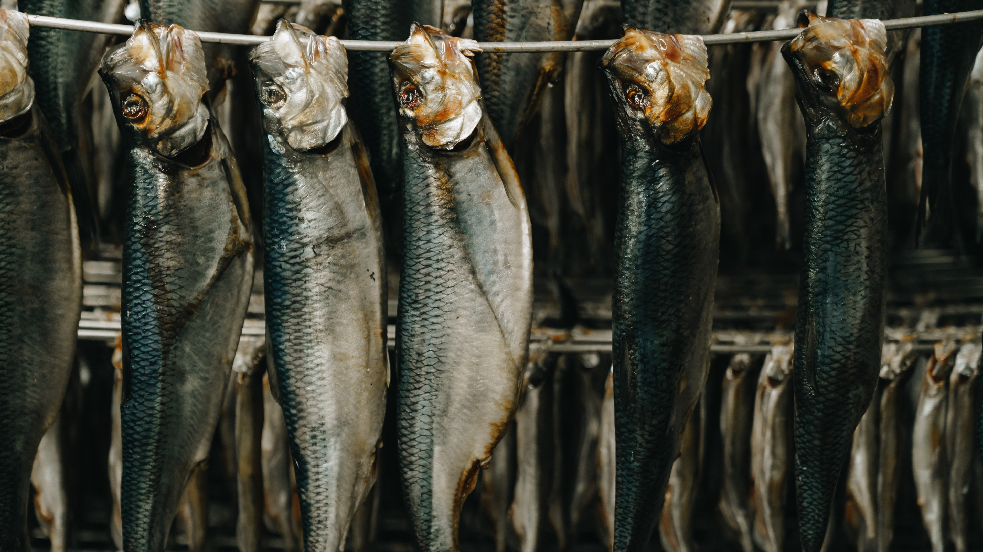
evals.datagrillen.com
Hang on, there is one more thing:
Please evaluate this session.

